Slide 1


EDA using Air BNB Dataset
By
T. Sai Harish Sarma

Slide 2

Contents
What is Air BNB
Business Context
Problem Statement
Tools used for EDA
Data Preparation
Data Exploration
Conclusion

Slide 3
What is Air BNB?
Air BNB is an American San Fransisco – based company operating an online market place for short term home stays and experiences.
Air BNB makes money by taking a cut in every reservation made by customer.
Air BNB means Air Bed and Breakfast.

Slide 4
Business Context
Since 2008, guests and hosts have used Airbnb to expand on travelling possibilities and present a more unique, personalized way of experiencing the world. Today Airbnb became one of a kind service that is used and recognized by the whole world, Data Analysis on millions of listings provided through Airbnb is a crucial factor for the company. These millions of listings generate a lot of data - data that can be analyzed and used for security, business decisions, understanding of customers and providers (hosts) behavior and performance on the platform, guiding marketing initiatives, implementation of innovative additional services and much more.

Slide 5
Problem Statement
Are Private rooms preferred over other room types?
Is Manhattan neighbor group preferred more over other groups?

Slide 6
Tools Used
Google Collaboratory for Python
Pandas Library
Matplotlib Library

Slide 7
Data Preparation
Around 49,000 observations
16 columns
A mix of categorical and numeric values

Slide 8
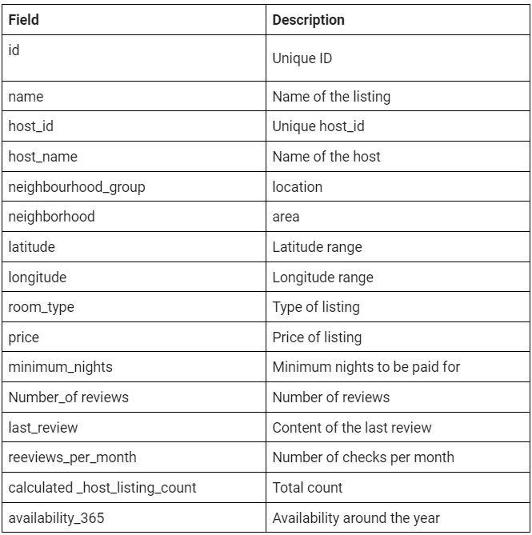
Data Preparation
16 columns

Slide 9
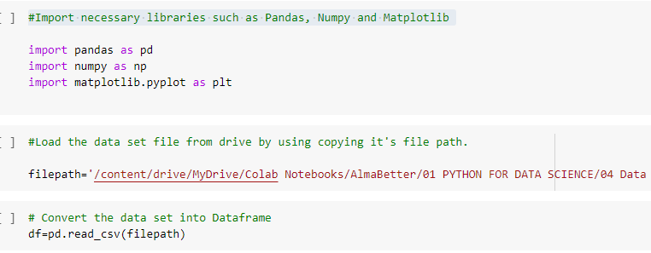

Data Preparation

Slide 10
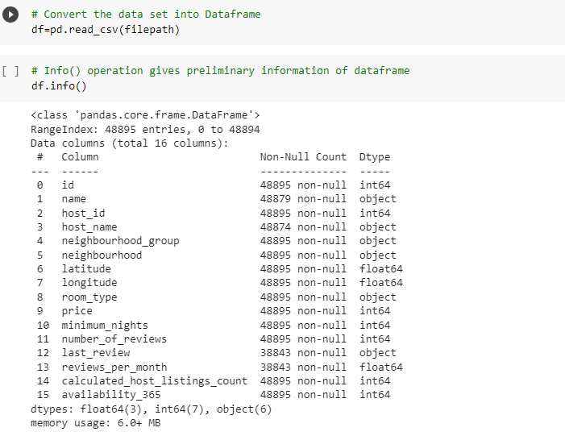
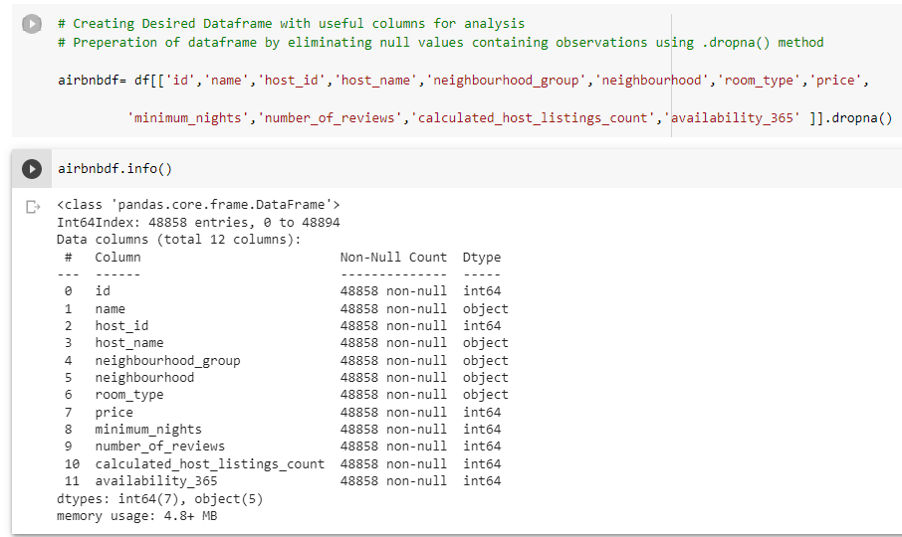
Data Preparation

Slide 11
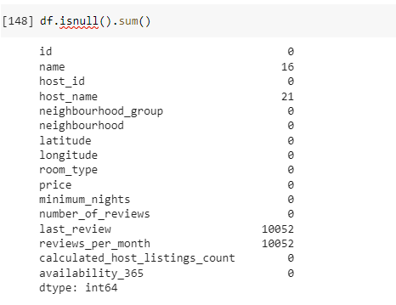
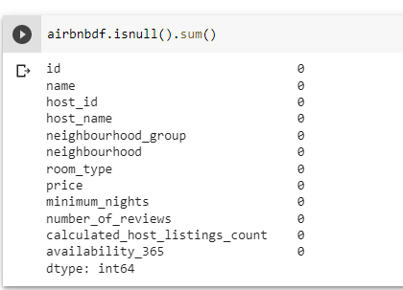
Data Preparation

Slide 12
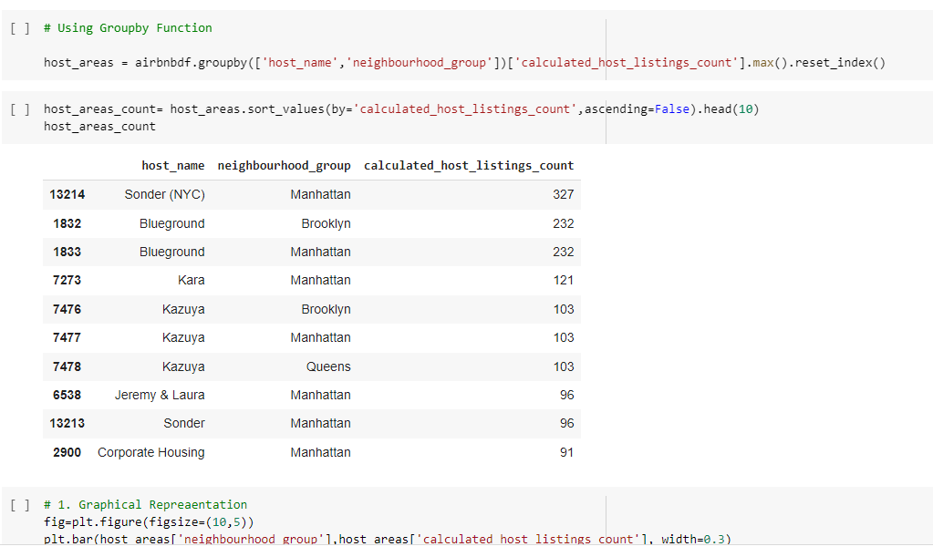
Data Exploration
1. Which of the group(s) is/are rich in having highest listings?

Slide 13
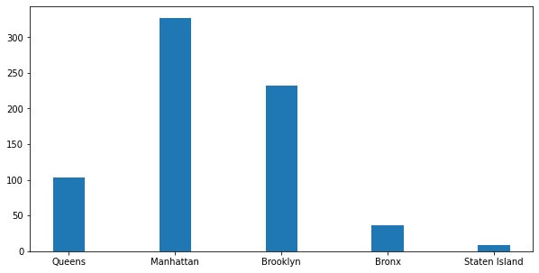
Data Exploration
1. Which of the group(s) is/are rich in having highest listings?

Slide 14
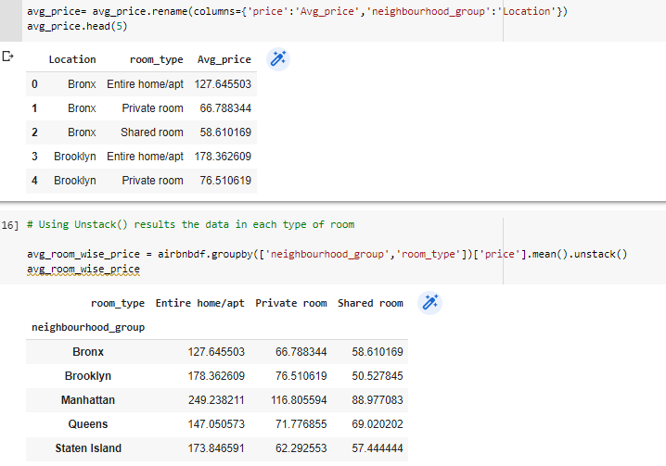
Data Exploration
2. What is the average price range in each type of room?

Slide 15
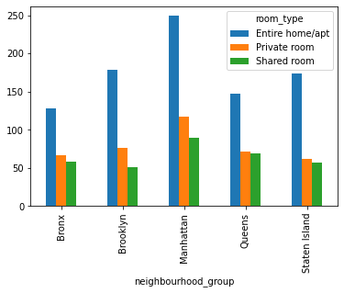
Data Exploration
2. What is the average price range in each type of room?

Slide 16
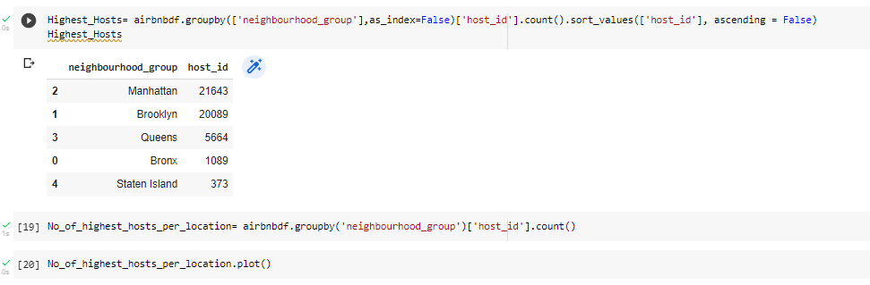
Data Exploration
3. Which group has highest number of hosts?

Slide 17
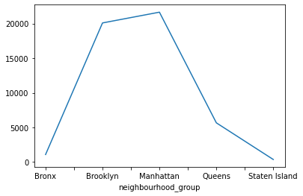
Data Exploration
3. Which group has highest number of hosts?

Slide 18
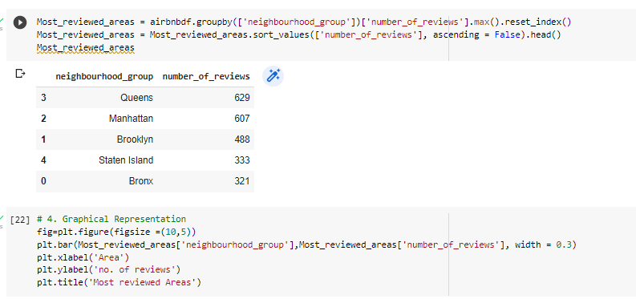
Data Exploration
4. Which group is most reviewed one?

Slide 19
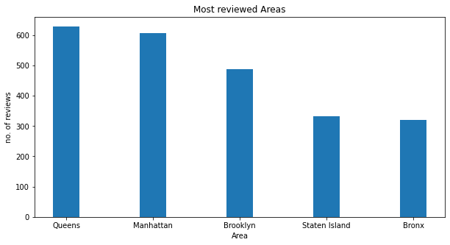
Data Exploration
4. Which group is most reviewed one?

Slide 20
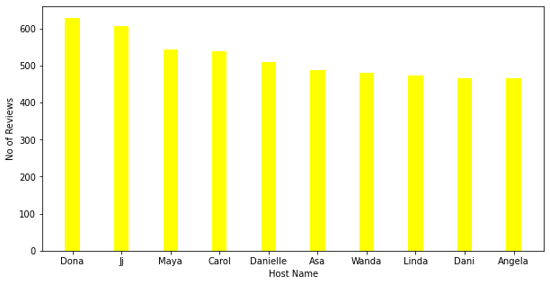
Data Exploration
5. Which Host is the busiest one with more reviews?
Dona of Queens Group has highest reviews 629, followed by Jj of Manhattan with 607.

Slide 21
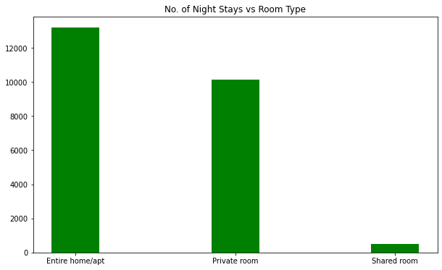
Data Exploration
6. Which type room is preferred by Tourists (i.e those who stay more nights)?

Slide 22
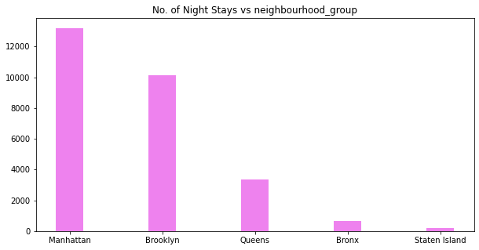
Data Exploration
7. Which group is preferred by Tourists (i.e. those who stay more nights)?

Slide 23
Conclusion
"Manhattan" is topped by having highest number of listings, where the group " Staten Island" is at least position.
"Manhattan" is the group, which is very expensive in all types of rooms compare to other groups.
In Shared room Category, Brooklyn offers at cheap price.
Queens group is very economical when comes to Private room.
In entire room/apt category, Manhattan is costlier and Bronx group offers at less cost.
Manhattan having 21643 unique hosts, where Brooklyn having 20089 hosts. Here we can observe that there is slight difference with no. of unique hosts between Manhattan and Brooklyn Group.

Slide 24
Conclusion
The Queen Group is reviewed well compared to other groups.
Entire room/ apt and Private rooms are more preferred for staying more nights.
And Manhattan is the best location to stay for more nights.

Slide 25
Thank you

